Slide 1

Networking and Internetworking
From Coulouris, Dollimore, Kindberg and Blair
Distributed Systems:
Concepts and Design

Slide 2
Introduction
Types of Network
Network Principles
Internet Protocols
Case Studies: Ethernet, WiFi, Bluetooth and ATM

Slide 3
Introduction
The networks used in Distributed systems are built from a variety of
Transmission media – wire, cable, fibre and wireless channels
Hardware devices – routers, switches, bridges, hubs, repeaters and network interfaces
Software components – protocol stacks, commn. Handlers, drivers.
The collection of h/w and s/w components that provide communication facilities for a distributed system is referred as communication subsystem.
The Internet is a single communication subsystem providing communication between all of the hosts that are connected to it.
The Internet is constructed from many subnets. A subnet is a unit of routing (delivering data from one part of Internet to another); it is a collection of nodes that can all be reached on the same physical network.

Slide 4
Networking issues for distributed systems
Performance:
Latency – delay that occurs after a send operation is executed before data starts to arrive at the destination computer.
Data transfer rate – speed at which data can be transferred between two computers in the network once transmission has begun (in bits per second)
Message transmission time = latency+length/data transfer rate
Scalability:
Reliability:
Security:
Mobility:
Quality of Service:
Multicasting:

Slide 5
Types of Network
Main types of network that are used to support distributed systems: Personal Area Networks, Local Area Networks, Wide Area Networks, Metropolitan Area Networks and the wireless variants of them.
Internetworks such as the Internet are constructed from networks of all these types.
Personal Area Networks (PANs): PANs are a sub-category of local networks in which the various digital devices carried by a user are connected by a low-cost, low energy network. WPANs are of increasing importance because of mobile phones, PDAs. Digital cameras, so on.
Local Area Networks (LANs): LANs carry messages at relatively high speeds between computers connected by a single communication medium such as twisted copper wire, coaxial cable or optical fibre.
Wide Area Networks (WANs): WANs carry message at lower speeds between nodes that are often in different organizations and may be separated by large distances. They may be located in different cities, countries or continents.
Metropolitan Area Networks (MANs): This type of network is based on the high-bandwidth copper and fibre optic cabling recently installed in some towns and cities for the transmission of video, voice and other data over distances of upto 50 kilometers.
WLANs, WMANs, WWANs
Internetworks: An internetwork is a communication subsystem in which several networks are linked together to provide common data communication facilities that overlay the technologies and protocols of the individual component networks and the methods used for their interconnection.

Slide 6
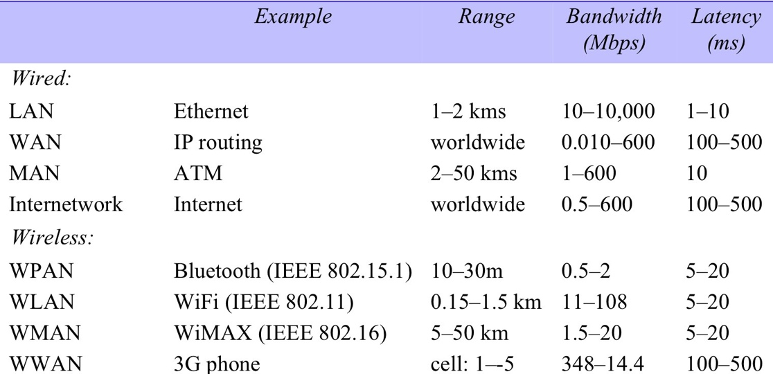
Figure 3.1
Network performance
km

Slide 7
Network Principles
Packet transmission: enables data packets addressed to different destinations to share a single commn. Link. The simplest form of packet is a sequence of binary data of restricted length, together with addressing information sufficient to identify the source and destination computers.
Data Streaming: Multimedia applications rely upon the transmission of streams of audio and video data elements at guaranteed rates and with bounded latencies. Such streams differ substantially from the message-based type of traffic for which packet transmission was designed.
Switching schemes: A network consists of a set of nodes connected together by circuits. To transmit information between two arbitrary nodes, a switching system is required. Four types of switching are used in computer networking.
Broadcast – is a transmission technique that involves no switching. Everything is transmitted to every node.
Circuit switching – telephone networks (POTs)
Packet switching – store and forward network
Frame relay

Slide 8
Protocols
Protocol is used to refer to a well-known set of rules and formats to be used for communication between processes in order to perform a given task. Ex: Transport protocol transmits messages of any length from a sending process to a receiving process.
Protocol Layers: Network software is arranged in a hierarchy of layers.
On the sending side, each layer (except the topmost) accepts items of data in a specified format from the layer above it and applies transformations to encapsulate the data in the format specified for that layer before passing it to the layer below for further processing.

Slide 9
Figure 3.2
Conceptual layering of protocol software
Message sent
Message received
Layer n
Layer 2
Layer 1
Sender
Communication
Recipient
medium

Slide 10
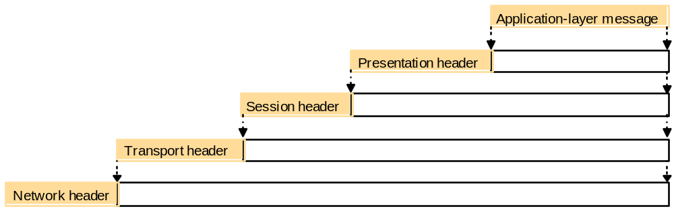
Figure 3.3
Encapsulation as it is applied in layered protocols

Slide 11
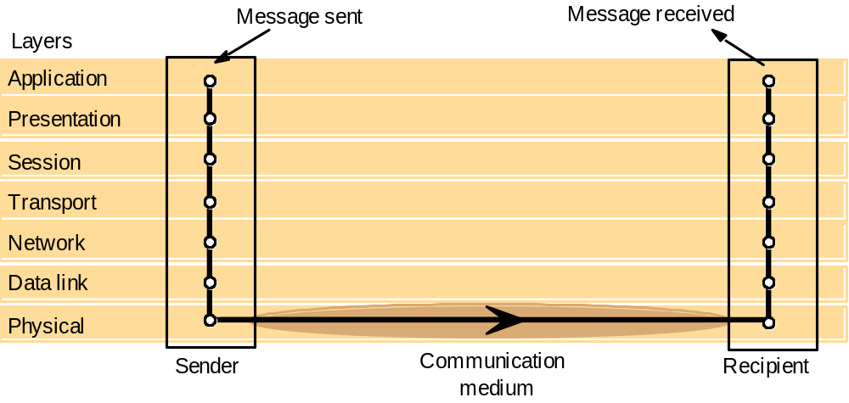
Figure 3.4
Protocol layers in the ISO Open Systems Interconnection (OSI) model

Slide 12
Figure 3.5
OSI protocol summary
Layer
Description
Examples
Application
Protocols that are designed to meet the communication requirements of
HTTP,
FTP
,
SMTP,
specific applications, often defining the interface to a service.
CORBA IIOP
Presentation
Protocols at this level transmit data in a network representation that is
Secure Sockets
independent of the representations used in individual computers, which may
(
SSL),CORBA Data
differ. Encryption is also performed in this layer, if required.
Rep.
Session
At this level reliability and adaptation are performed, such as detection of
failures and automatic recovery.
Transport
This is the lowest level at which messages (rather than packets) are handled.
TCP,
UDP
Messages are addressed to communication ports attached to processes,
Protocols in this layer may be connection-oriented or connectionless.
Network
Transfers data packets between computers in a specific network. In a WAN
IP,
ATM virtual
or an internetwork this involves the generation of a route passing through
circuits
routers. In a single LAN no routing is required.
Data link
Responsible for transmission of packets between nodes that are directly
Ethernet MAC,
connected by a physical link. In a WAN transmission is between pairs of
ATM cell transfer,
routers or between routers and hosts. In a LAN it is between any pair of hosts.
PPP
Physical
The circuits and hardware that drive the network. It transmits sequences of
Ethernet base- band
binary data by analogue signalling, using amplitude or frequency modulation
signalling,
ISDN
of electrical signals (on cable circuits), light signals (on fibre optic circuits)
or other electromagnetic signals (on radio and microwave circuits).

Slide 13
Protocol Suite
A complete set of protocol layers is referred to as a protocol suite or a protocol stack, reflecting the layered structure.
The application and presentation layers are implemented either as a single middleware layer or separately within each application. The session layer is integrated with the transport layer. Internetwork protocol suites include an application layer, a transport layer and an internetwork layer.
The Internetwork layer is a virtual network layer that is responsible for transmitting internetwork packets to a destination computer.
An Internetwork packet is the unit of data transmitted over an internetwork.
The network interface layer accepts internetwork packets and converts them into packets suitable for transmission by the network layers of each underlying network.

Slide 14
Protocol Suite
Packet Assembly – The task of dividing messages into packets before transmission and reassembling them at the receiving computer is performed in the transport layer. The network-layer protocol packets consist of a header and data field.MTU for Ethernet is 1500 bytes.
Ports – The transport layer’s task is to provide a network-independent message transport service between pairs of network ports. Ports are software defined destination points at a host computer.
Addressing – The transport layer is responsible for delivering messages to destinations with transport addresses that are composed of the network address of a host computer and a port number.
Packet delivery – Two approaches to the delivery of packets by the network layer.
Datagram packet delivery –In a datagram network a sequence of packets transmitted by a single host to a single destination may follow different routes and when this occurs they may arrive out of sequence.
Virtual circuit packet delivery - A virtual circuit must be set up before packets can pass from a source host A to destination host B. The establishment of a virtual circuit involves the identification of a route from the source to destination, possible passing through several intermediate nodes. At each node along the route a table entry is made, indicating which link should be used for the next stage of the route. Once a virtual circuit has been set up, it can be used to transmit any number of packets.

Slide 15
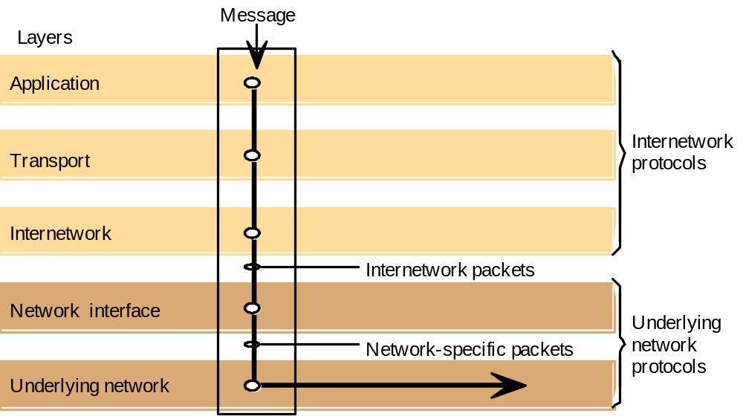
Figure 3.6
Internetwork layers

Slide 16
Routing
Routing is a function that is required in all networks except those LANs, such as the Ethernet, that provide direct connections between all pairs of attached hosts.
In large networks, adaptive routing is employed: the best route for communication between two points in the network is re-evaluated periodically, taking into account the current traffic in the network and any faults such as broken connections or routers.
The determination of routes for the transmission of packets to their destinations is the responsibility of a routing algorithm – implemented by a program in the network layer at each node.
A simple routing algorithm – Distance Vector algorithm.
A router exchanges information about the network with its neighbouring nodes by sending a summary of its routing table using a Router Information Protocol (RIP). The RIP actions performed at a router are
Periodically and whenever the local routing table changes, send the table to all accessible neighbours. (send RIP packet containing table to non-faulty outgoing link)
When a table is received from a neighbouring router, if the received table shows a route to a new destination, or a better (lower cost) route to an existing destination, then update the local table with the new route.
Tr is a table received from another router and Tl is the local table

Slide 17
Figure 3.7
Routing in a wide area network
A
1
B
Hosts
2
3
Links
4
or local
C
networks
5
D
6
E
Routers

Slide 18
Figure 3.8
Routing tables for the network in Figure 3.7
Routings from A
Routings from B
Routings from C
To
Link
Cost
To
Link
Cost
To
Link
Cost
A
local
0
A
1
1
A
2
2
B
1
1
B
local
0
B
2
1
C
1
2
C
2
1
C
local
0
D
3
1
D
1
2
D
5
2
E
1
2
E
4
1
E
5
1
Routings from D
Routings from E
To
Link
Cost
To
Link
Cost
A
3
1
A
4
2
B
3
2
B
4
1
C
6
2
C
5
1
D
local
0
D
6
1
E
6
1
E
local
0

Slide 19
Figure 3.9
Pseudo-code for RIP routing algorithm
Send: Each t seconds or when Tl changes, send Tl on each non-faulty outgoing link.
Receive: Whenever a routing table Tr is received on link n:
for all rows Rr in Tr {
if (Rr.link not equal to n) {
Rr.cost = Rr.cost + 1;
Rr.link = n;
if (Rr.destination is not in Tl) add Rr to Tl;
// add new destination to Tl
else for all rows Rl in Tl {
if (Rr.destination = Rl.destination and
(Rr.cost < Rl.cost or Rl.link = n)) Rl = Rr;
// Rr.cost < Rl.cost : remote node has better route
// Rl.link = n : remote node is more authoritative
}
}
}

Slide 20
1. Periodically, and whenever the local routing table changes, send the table (in a summary form) to all accessible neighbours. That is, send an RIP packet containing a copy of the table on each non-faulty outgoing link.
2. When a table is received from a neighbouring router, if the received table shows a route to a new destination, or a better (lower-cost) route to an existing destination, update the local table with the new route. If the table was received on link n and it gives a different cost than the local table for a route that begins with link n, replace the cost in the local table with the new cost. This is done because the new table was received from a router that is closer to the relevant destination and is therefore always more authoritative for routes that pass through it.

Slide 21
Internetworking
To build an integrated network(an internetwork) we must integrate many subnets, each of which is based on one of these network technologies. To make this possible, the following are needed:
A unified internetwork addressing scheme that enables packets to be addressed to any host connected to any subnet – provided by IP addresses
A protocol defining the format of internetwork packets and giving rules according to which they are handled – is the IP protocol
Interconnecting components that route packets to their destinations in terms of internetwork addresses, transmitting the packets using subnets with a variety of network technologies – performed by the components called Internet Routers.
Bridges – Bridges link networks of different types. Some bridges link several networks and these are referred to as bridge/routers because they also perform routing functions
Hubs – Hubs are simply a convenient means of connecting hosts and extending segments of Ethernet and other broadcast local network technologies.
Switches – Switches perform a similar function to routers, but for local networks(normally Ethernets) only. That is, they interconnect several separate Ethernets, routing the incoming packets to the appropriate outgoing network.
Tunnelling – A pair of nodes connected to separate networks of the same type can communicate through another type of network, they do so by constructing a protocol ‘tunnel’. A protocol tunnel is a software layer that transmits packets through an alien network environment.

Slide 22
Figure 3.11
Tunnelling for IPv6 migration
IPv6 encapsulated in IPv4 packets
IPv4 network
IPv6
IPv6
A
B
Encapsulators

Slide 23
Figure 3.12
TCP/IP layers
Message
Layers
Application
Messages (UDP) or Streams (TCP)
Transport
UDP or TCP packets
Internet
IP datagrams
Network interface
Network-specific frames
Underlying network

Slide 24
Figure 3.13
Encapsulation in a message transmitted via TCP over an Ethernet
Application message
TCP header
port
IP header
TCP
Ethernet header
IP
Ethernet frame

Slide 25

Figure 3.14
The programmer's conceptual view of a TCP/IP Internet

Slide 26
Internet Protocols
There are two transport protocols – TCP and UDP. TCP is a reliable connection-oriented protocol and UDP is a datagram protocol that does not guarantee reliable transmission.
The Internet Protocol (IP) is the underlying network protocol of the Internet Virtual Network – that is, IP datagrams provide the basic transmission mechanism for the Internet and other TCP/IP networks.
IP Addressing
The most challenging aspect of the design of the Internet protocols was the construction of schemes for naming and addressing hosts and for routing IP packets to their destinations.
The scheme chosen assigns an IP address to each host in the Internet – a 32 bit numeric identifier containing a network identifier, which uniquely identifies one of the subnetworks in the Internet and a host identifier, which uniquely identifies the host’s connection to that network. It is these addresses that are placed in IP packets and used to route them to their destinations.
There are four allocated classes of Internet Address – A, B, C and D.
Class D is reserved for Internet Multicast communication, which is implemented in only some Internet routers. Class E contains a range of unallocated addresses, which are reserved for future requirements.

Slide 27
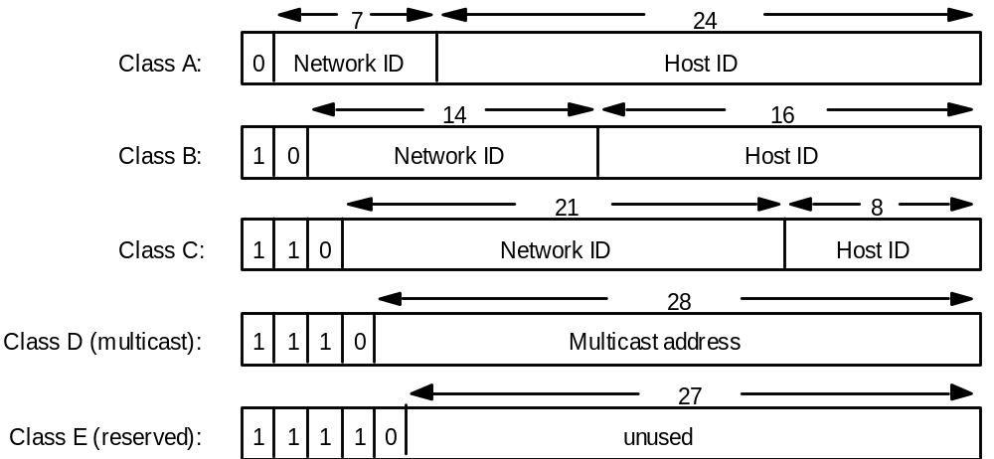
Figure 3.15
Internet address structure, showing field sizes in bits
28

Slide 28
Figure 3.16
Decimal representation of Internet addresses
octet 1
octet 2
octet 3
Range of addresses
Network ID
Host ID
Class A:
1 to 127
0 to 255
0 to 255
0 to 255
1.0.0.0 to
127.255.255.255
Network ID
Host ID
Class B:
128 to 191
0 to 255
0 to 255
0 to 255
128.0.0.0 to
191.255.255.255
Network ID
Host ID
Class C:
192 to 223
0 to 255
0 to 255
1 to 254
192.0.0.0 to
223.255.255.255
Multicast address
Class D (multicast):
224 to 239
0 to 255
0 to 255
1 to 254
224.0.0.0 to
239.255.255.255
Class E (reserved):
240 to 255
0 to 255
0 to 255
1 to 254
240.0.0.0 to
255.255.255.255
These 32-bit Internet addresses containing a network identifier and host identifier are usually written as
a Sequence of four decimal numbers separated by dots. Each decimal number represents one of the
four Bytes, or octets of the IP address.
Class A addresses with a capacity for 2²⁴ hosts on each subnet, are reserved for very large networks
such as the US NSFNet.
Class B addresses are allocated to organizations that operate networks likely to contain more than 255
Computers, and
Class C addresses are allocated to all other network operators.

Slide 29
IP Protocol
The IP protocol transmits datagrams from one host to another, if necessary via intermediate routers.
IP provides a delivery service that is described as offering unreliable because there is no guarantee of delivery. Packets can be lost, duplicated, delayed or delivered out of order, but these errors arise only when the underlying networks fail or buffers at the destination are full. The only checksum in IP is a header checksum, which is inexpensive to calculate and ensures that any corruptions in the addressing and packet management data will be detected. There is no data checksum.
Address resolution – The address resolution module is responsible for converting Internet addresses to network addresses for a specific underlying network (physical addresses)
Ex: If the underlying network is an Ethernet, the Address Resolution Module converts 32 bit Internet addresses to 48 bit Ethernet Addresses.
The ARP module on each host maintains a cache of (IP address, Ethernet Address) pairs that it has previously obtained. If the required IP address is in the address, then the query is answered immediately. If not, then ARP transmits an Ethernet broadcast packet (an ARP request packet) on the local Ethernet containing the desired IP address. Each of the computer on the local Ethernet receives the ARP request packet and checks the IP address in it to see whether it matches its own IP address. If it does, an ARP reply packet is sent to the originator of the ARP request containing the sender’s Ethernet Address.

Slide 30
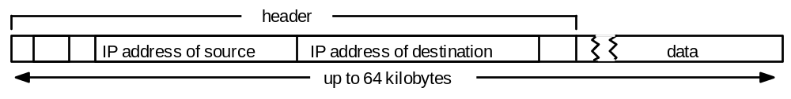
Figure 3.17
IP packet layout

Slide 31
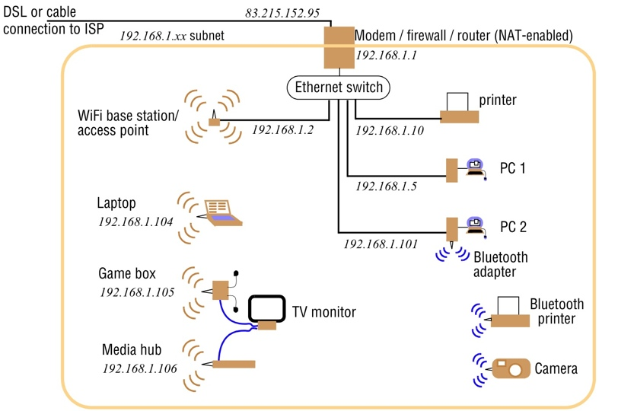
Figure 3.18
A typical NAT-based home network

Slide 32
Figure 3.19
IPv6 header layout
Version (4 bits)
Traffic class (8 bits)
Flow label (20 bits)
Payload length (16 bits)
Next header (8 bits)
Hop limit (8 bits)
Source address
(128 bits)
Destination address
(128 bits)

Slide 33
Figure 3.20
The MobileIP routing mechanism
Sender
Subsequent IP packets
tunnelled to FA
Mobile host MH
Address of FA
returned to sender
First IP packet
addressed to MH
Internet
Foreign agent FA
Home
First IP packet
agent
tunnelled to FA
When the mobile host is connected at its home base, packets are routed to it in the normal
way.
When it is connected to the Internet elsewhere, two agent processes take responsibility
for rerouting.
The agents are Home agent (HA) and a foreign agent (FA).
These processes run on convenient fixed computers at the home Site and at the current
location of the mobile host.

Slide 34
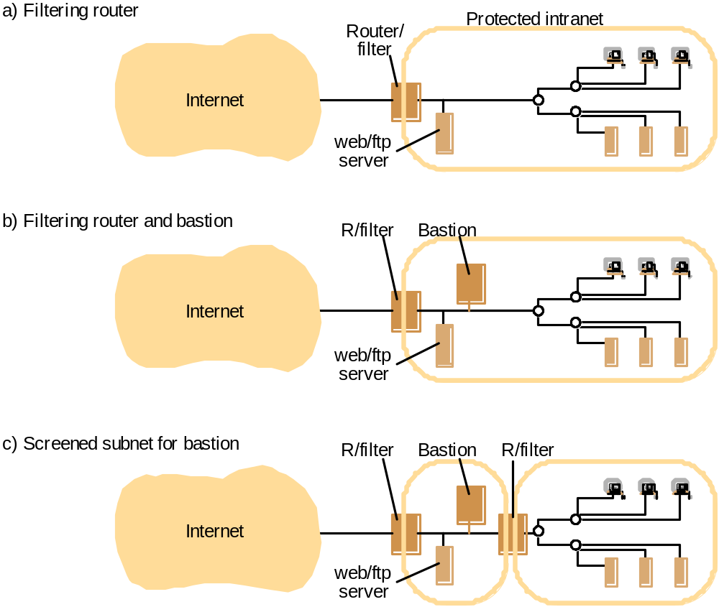
Figure 3.21
Firewall configurations

Slide 35
Figure 3.22
IEEE 802 network standards
IEEE No.
Name
Title
Reference
802.3
Ethernet
CSMA/CD Networks (Ethernet)
[IEEE 1985a]
802.4
Token Bus Networks
[IEEE 1985b]
802.5
Token Ring Networks
[IEEE 1985c]
802.6
Metropolitan Area Networks
[IEEE 1994]
802.11
WiFi
Wireless Local Area Networks
[IEEE 1999]
802.15.1
Bluetooth
Wireless Personal Area Networks
[IEEE 2002]
802.15.4
ZigBee
Wireless Sensor Networks
[IEEE 2003]
802.16
WiMAX
Wireless Metropolitan Area Networks
[IEEE 2004a]

Slide 36
Figure 3.23
Ethernet ranges and speeds
10Base5
10BaseT
100BaseT
1000BaseT
Data rate
10 Mbps
10 Mbps
100 Mbps
1000 Mbps
Max. segment lengths:
Twisted wire (UTP)
100 m
100 m
100 m
25 m
Coaxial cable (STP)
500 m
500 m
500 m
25 m
Multi-mode fibre
2000 m
2000 m
500 m
500 m
Mono-mode fibre
25000 m
25000 m
20000 m
2000 m

Slide 37
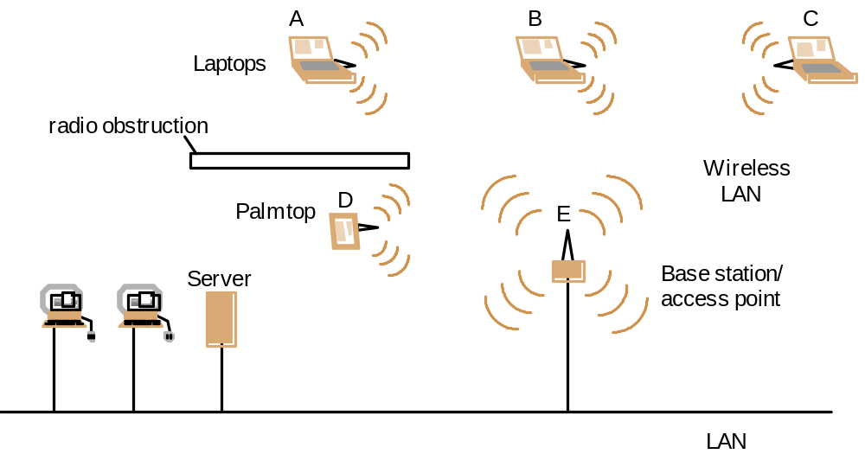
Figure 3.24
Wireless LAN configuration

Slide 38
Figure 3.25
Bluetooth frame structure
bits: 72
18
18
18
0 - 2744
Access code
Header
Header
copy 2
Header
Data for transmission
copy 1
copy 3
Header
bits: 3
1
1
1
4
8
Destination
Flow
Ack
Seq
Type
Header checksum
Address within
= ACL, SCO,
Piconet
poll, null
SCO packets (e.g. for voice data) have a 240-bit payload containing 80 bits of data triplicated, filling exactly one timeslot.

